Slide 1

Wizard Assassin
T4 Capstone

Slide 2
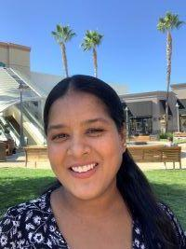
Meet the Team!
Mayuri Dalavai
Experience:
Military Spouse
B. Tech in Electronics and Communication Engineering
Learn Academy Coding Bootcamp
Programming experience:
JavaScript, HTML, CSS, Beginner Java, Python

Slide 3
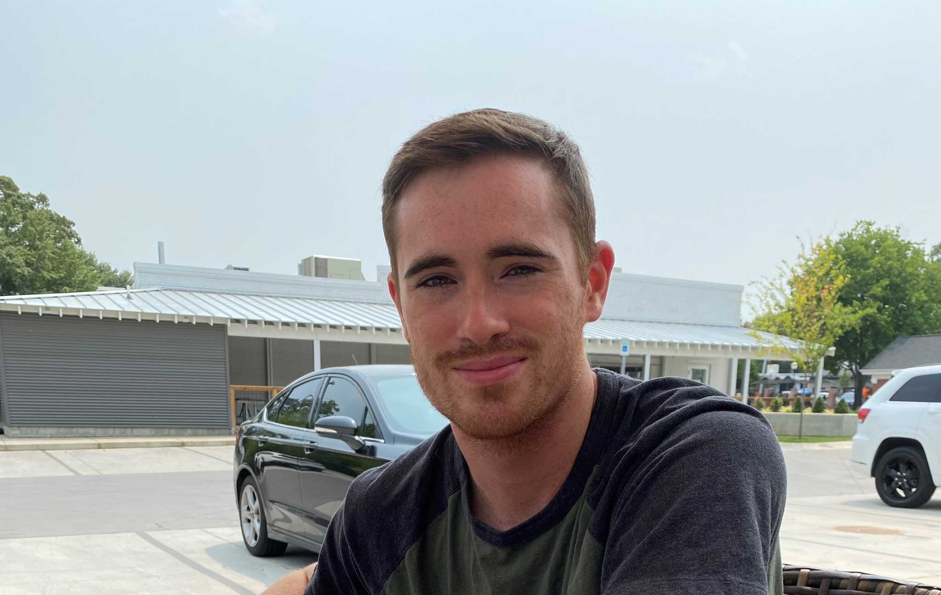
Meet the Team!
Brandon Copeland
Experience:
Army National Guard
B.S. Biochemistry
App Academy Coding Bootcamp
Programming Experience:
Java, Python, JavaScript, HTML/CSS

Slide 4


Meet the Team!
Duncan Bonacuse
Experience:
US Army Reserve
B.S. Neuroscience, B.A. Poli Sci
Beginner in Java, Python, HTML/CSS, JavaScript

Slide 5

Wizard Assassin GUI-Based Adventure Game
Single player role-playing game
Our team’s objective was to take a command line-driven, text-based game and convert it into a graphical user interface utilizing Java Swing
GUI allows for a more interactive and user-friendly experience

Slide 6
Features and Functions
Converted text-based game into GUI
Easy JList ‘select’ options for user-input nouns
Easy JButton ‘submit’ options for user-input verbs
Menu Bar with separate JFrames for Music, Map and Help
Easy to read dialogue box with game text, including current location
Broke down different player actions into separate methods
In-game ‘Quit’ option returns player to title frame

Slide 7
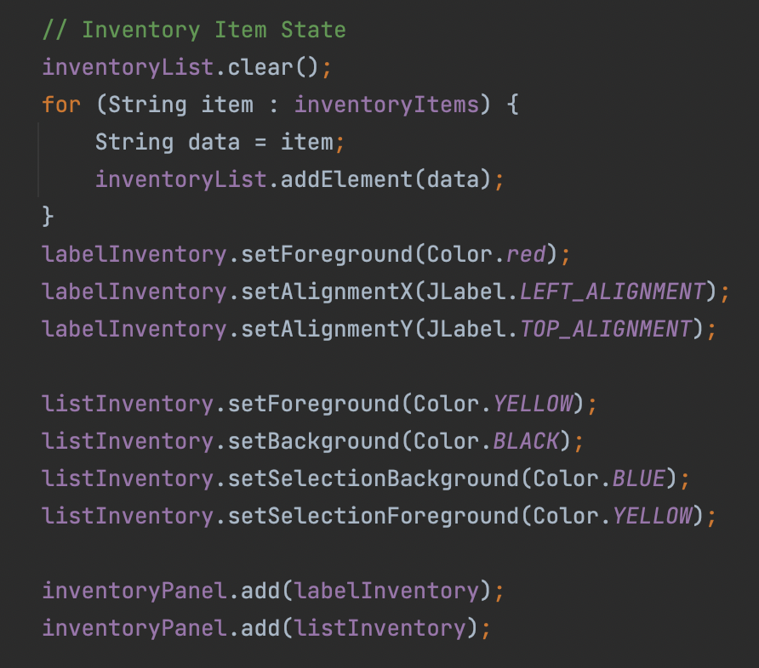
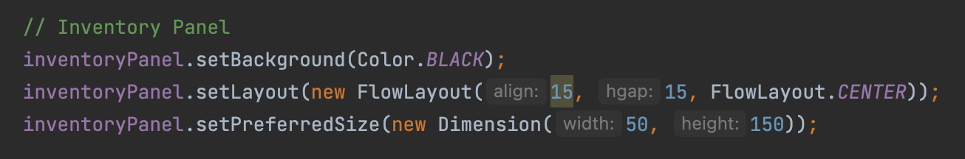
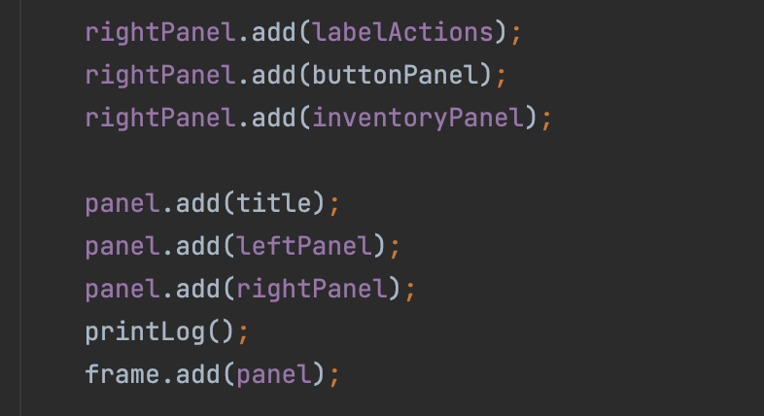
Features and Functions: JLists, Game panels

Slide 8
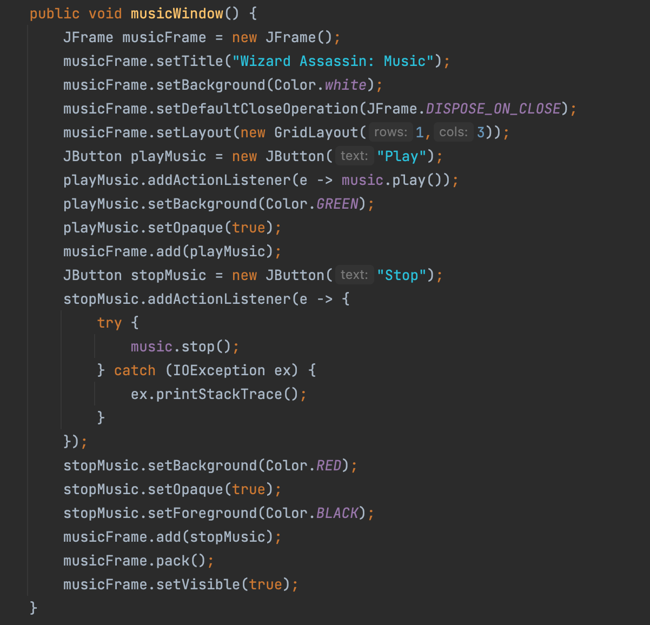
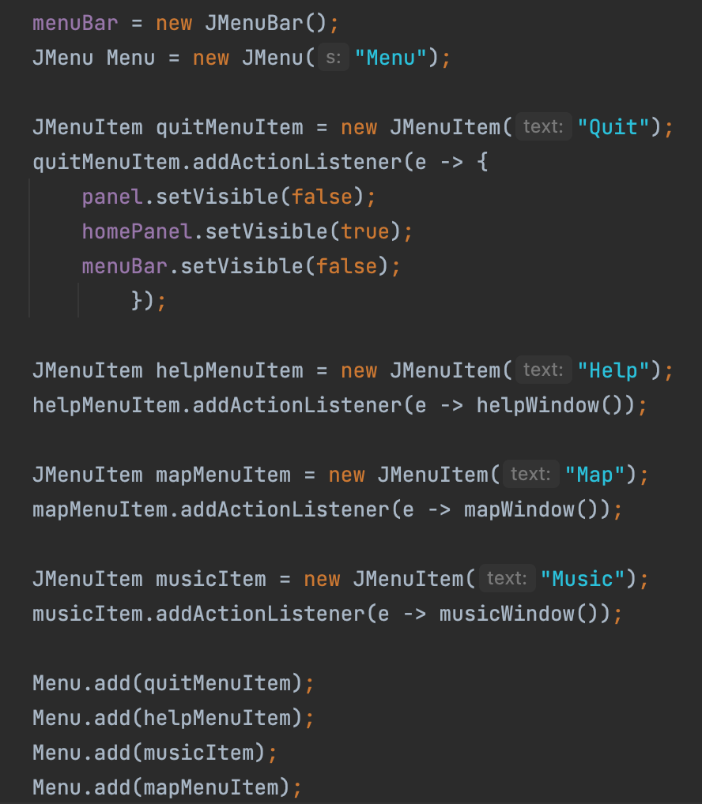
Features and Functions: Music, JMenu

Slide 9
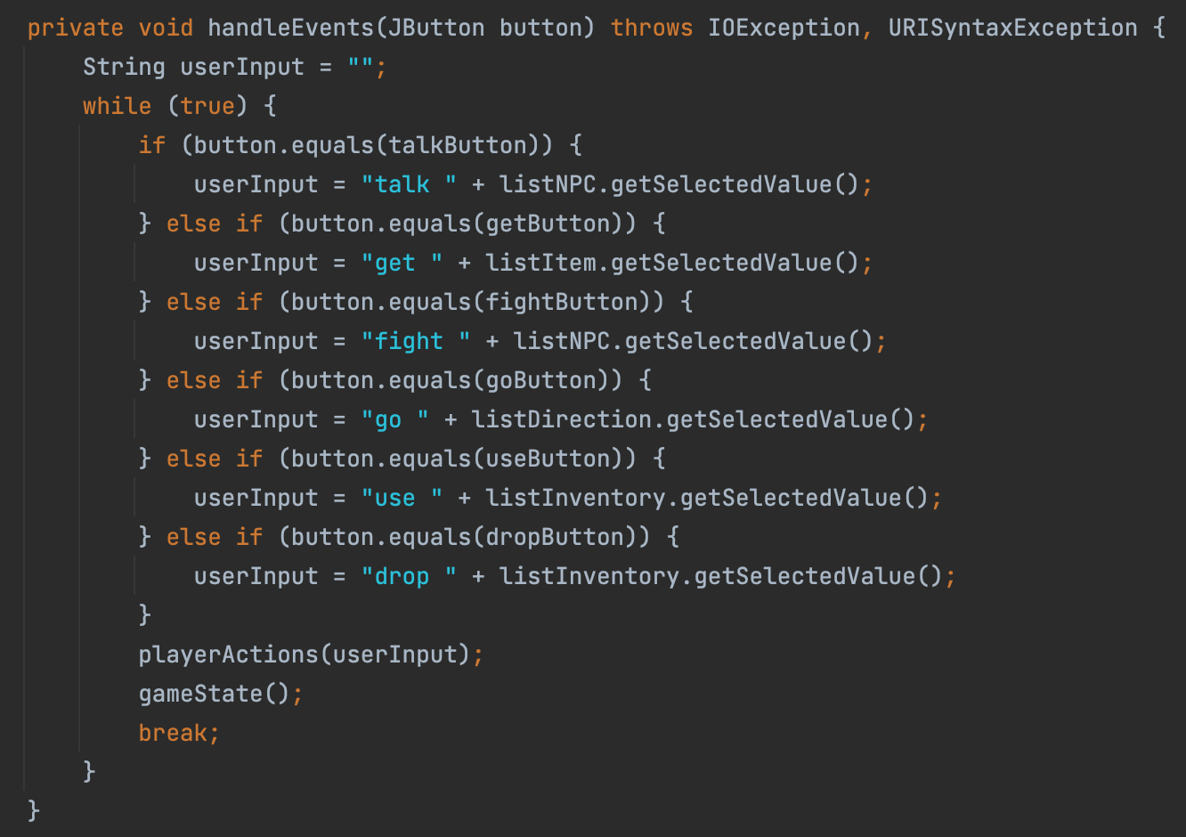
Features and Functions: User-Input Verb JButtons

Slide 10
Challenges
Challenge #1: Refactoring code from another development team. Required time to learn the code and how each method applied to different aspects of the game
Challenge #2: Learning Java Swing and all its features and quirks, especially differences between operating systems
Challenge #3: Building a JAR file that properly utilized our resource folders

Slide 11
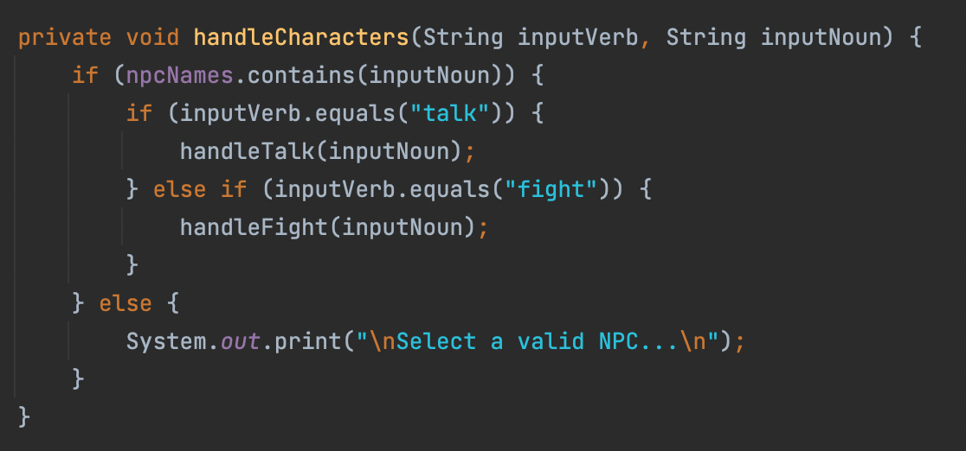
Challenge #1 Resolution
Broke down chunks of unknown code into segments that our team could understand

Slide 12
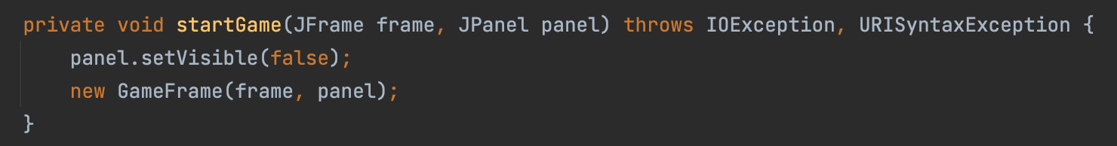
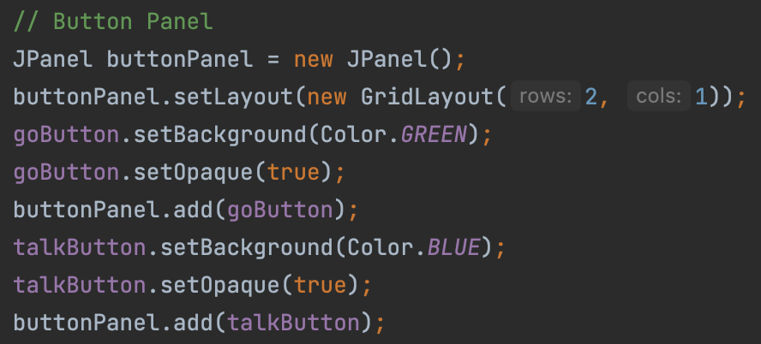
Challenge #2 Resolution
Researching Swing and how to build the game using Frames and swapping Panels. Determined which design components best fit on MacOS and Windows.

Slide 13
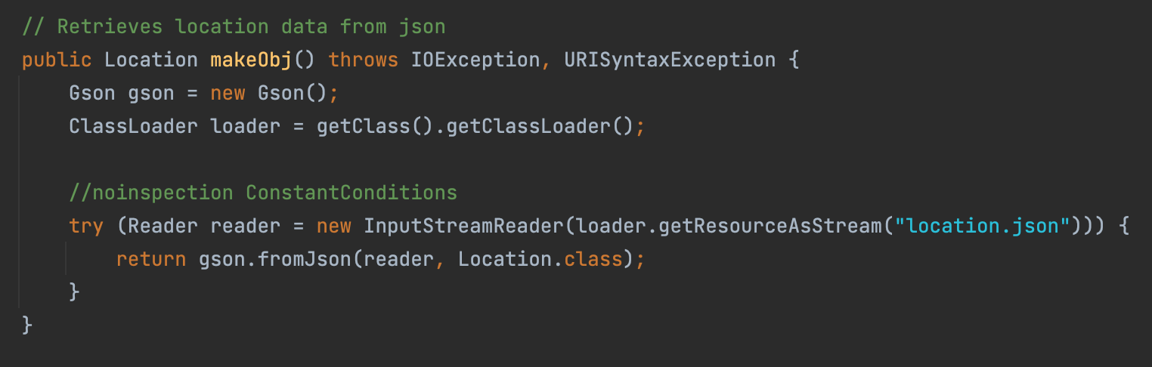
Challenge #3 Resolution
Used ClassLoader and InputStreamReader to access our resources (json files, images, audio files) and include them in the JAR

Slide 14
Achievements
Managed to consolidate and refactor unfamiliar code
Team coordinated effectively to avoid Git merge conflicts
Created user-friendly and bug-free graphical user interface
Utilizing CustomOutputStream to override System.out.println() method from the command line, and placing relevant text in JTextArea

Slide 15
Agile Principles
Mayuri: #3: Deliver working software frequently, from a couple of weeks to a couple of months, with a preference to the shorter timescale.
Brandon: #7 – Working software is the primary measure of progress.
Duncan: #12 – At regular intervals, the team reflects on how to become more effective, then tunes and adjusts its behavior accordingly.

Slide 16
Demo

Slide 17
Future Release Additions
Game imagery
Refactoring navigation from JList ‘select’ to a direction pad
Sound FX and additional sound controls
Updating map with player location

Slide 18
Questions?

Slide 19
Thank you!

